Slide 1
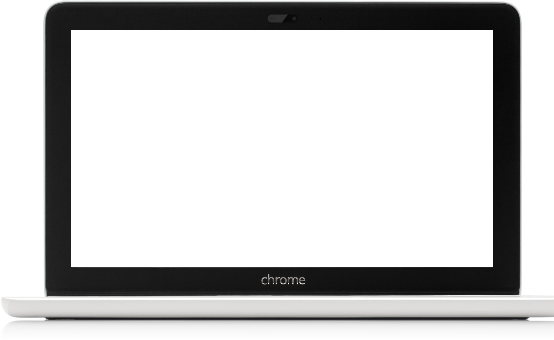
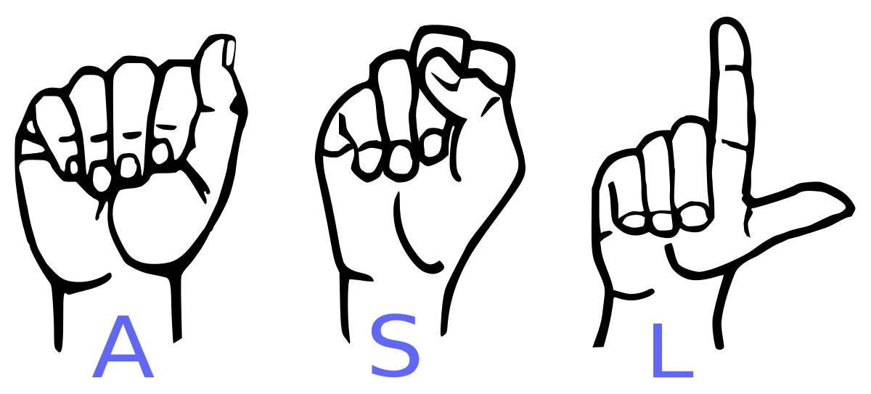
“Anuvadak”
Sign Language to Text Converter
For Dumb and Deaf

Slide 2
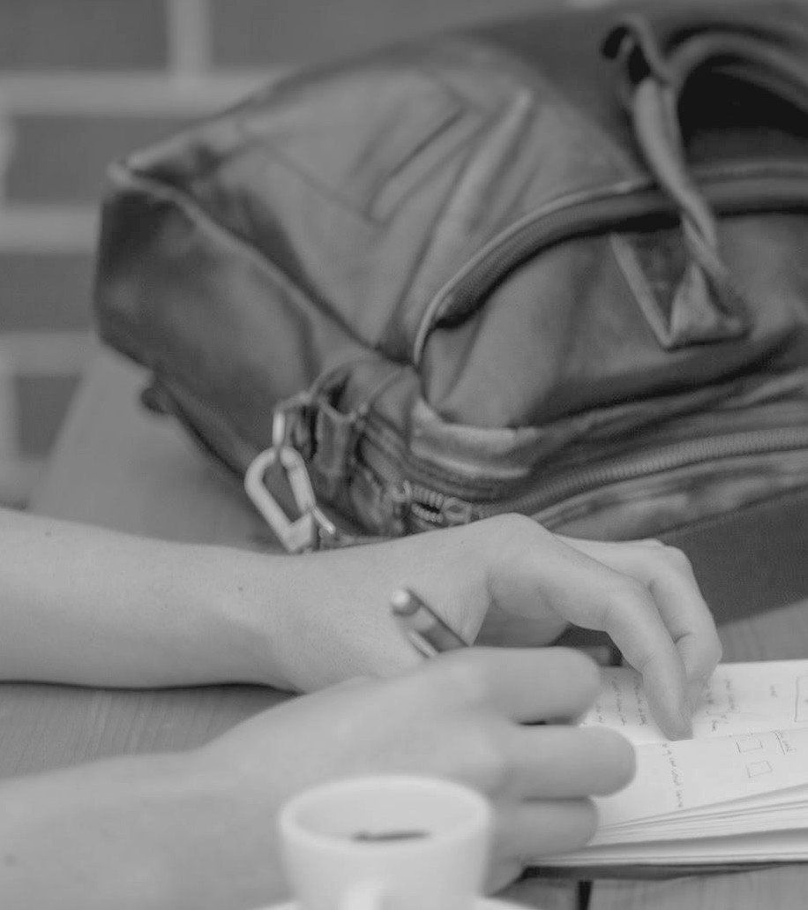
Abstract
Our project aims to create a computer application and train a model which when shown a real time video of hand gestures of American Sign Language shows the output for that particular sign in text format on the screen.

Slide 3
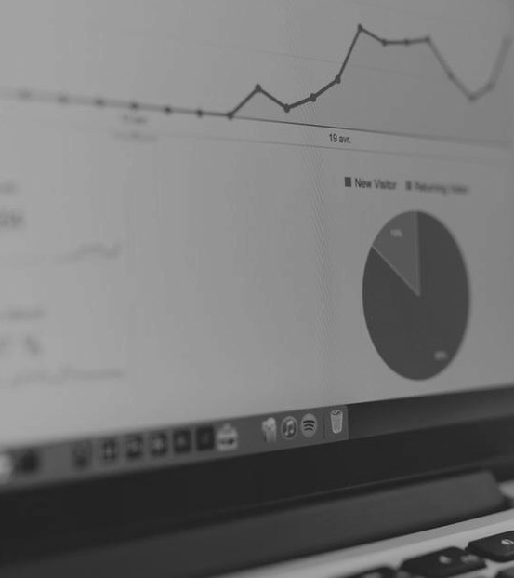
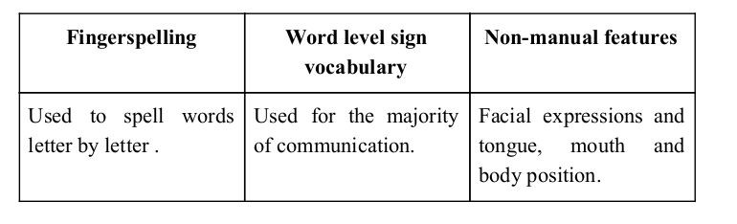
Sign language is a visual language and consists of 3 major components:

Slide 4
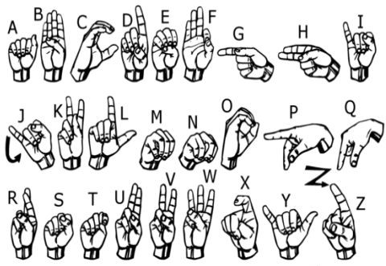
We implemented 27 symbols(A-Z, blank) of ASL in our project.

Slide 5
Methodology

Slide 6
How we generated data set and did Data Preprocessing ?

Slide 7
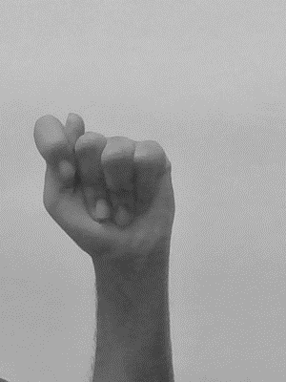
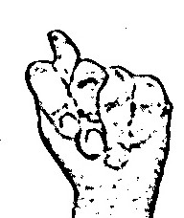
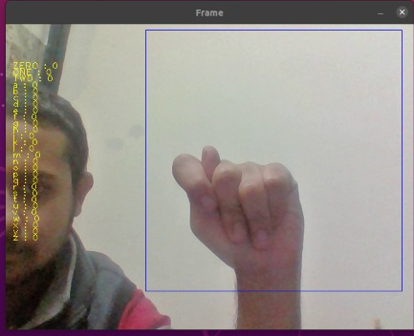
Capturing Raw Image
Gray Scale Image
Image post Gaussian Blur

Slide 8
Gesture Classification

Slide 9
Algorithm Layer :
Apply gaussian blur filter and threshold to the frame taken with opencv to get the processed image after feature extraction.
This processed image is passed to the CNN model for prediction and if a letter is detected for more than 60 frames then the letter is printed and taken into consideration for forming the word.
Space between the words are considered using the blank symbol.

Slide 10
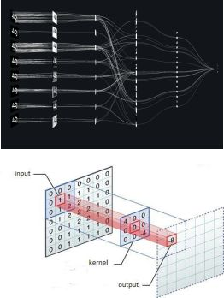
Convolutional Neural Networks
CNNs consist of multiple convolutional layers each layer containing numerous “filters” which perform feature extraction.
Initially these “filters” are random and by training, the feature extraction gets better by better.
It’s primarily used for image classification.

Slide 11
Our CNN Classifier Model

Slide 12
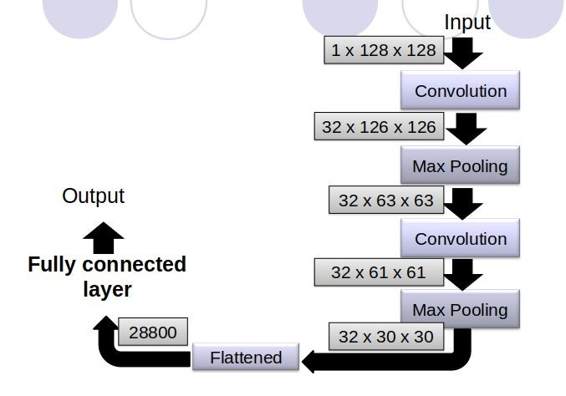

Slide 13
Finger Spelling Sentence Formation

Slide 14
Implementation
Whenever the count of a letter detected exceeds a specific value and no other letter is close to it by a threshold we print the letter and add it to the current string(In our code we kept the value as 60).
Otherwise we clear the current dictionary which has the count of detections of present symbol to avoid the probability of a wrong letter getting predicted.
Whenever the count of a blank(plain background) detected exceeds a specific value and if the current buffer is empty no spaces are detected.
In other case it predicts the end of word by printing a space and the current gets appended to the sentence below.

Slide 15
Implementation

Slide 16
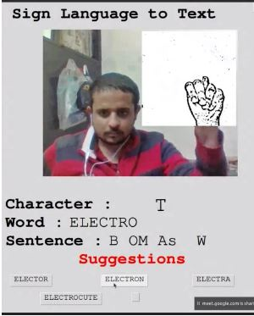
App Interface
Tkinter library for GUI
Character ,word and sentence feature
Suggestion feature

Slide 17
Autocorrect feature
A python library Hunspell_suggest is used to suggest correct alternatives for each (incorrect) input word and we display a set of words matching the current word in which the user can select a word to append it to the current sentence.This helps in reducing mistakes committed in spellings and assists in predicting complex words.

Slide 18
Software Requirements
Python 3.6.6
Tensorflow 1.11.0
OpenCV 3.4.3.18
NumPy 1.15.3
Matplotlib 3.0.0
Hunspell 2.0.2
Keras 2.2.1
PIL 5.3.0

Slide 19
Conclusion
In this report, a functional real time vision based American Sign Language recognition for D&M people have been developed for ASL alphabets.
We achieved an accuracy of 96.5% on our dataset.
Prediction has been improved after implementing the convolutional nueral network to predict symbols which are more similar to each other.

Slide 20
Efforts by
Project Under Supervision of
Dr. Neena Gupta
Ritik Gupta - 18105106
Aditya Mehta- 18105107
Arjun Narula- 18105114 Dhaval Gupta- 18105115

Slide 21
Thank You !

